Slide 1
RGB BOX, INDONESIA FLAG & FLIP IMAGE USING PYTHON
Imanuel Ronaldo/ 2103161044

Slide 2
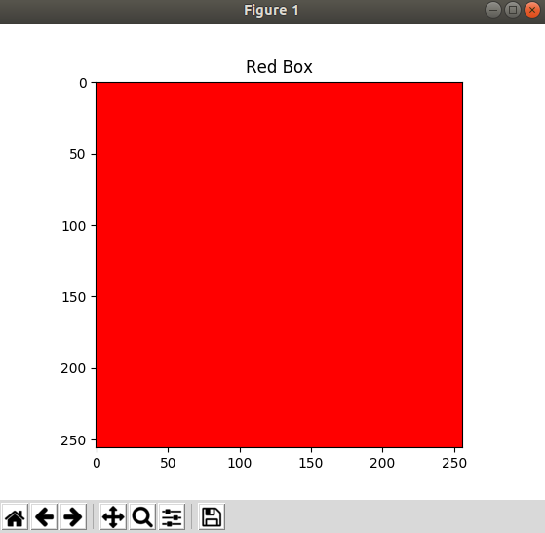
RGB – Red Box
import numpy as np
import matplotlib.pyplot as plt
import imageio
img_red = np.zeros((256, 256,3), dtype=np.uint8)
for y in range(0, 256):
for x in range(0, 256):
for c in range(0,3):
if c ==0:
img_red[y][x][c] = 255
else:
img_red[y][x][c] = 0
plt.imshow(img_red)
plt.title("Red Box")
plt.show()

Slide 3
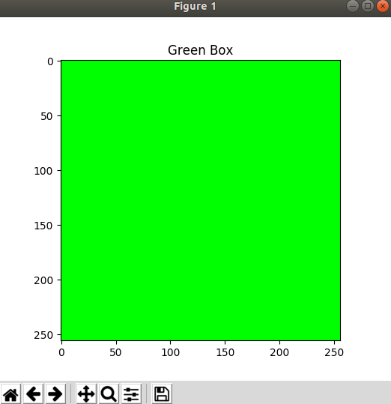
RGB – Green Box
import numpy as np
import matplotlib.pyplot as plt
import imageio
img_green = np.zeros((256,256,3), dtype=np.uint8)
for y in range(0, 256):
for x in range(0, 256):
for c in range(0,3):
if c ==1:
img_green[y][x][c] = 255
else:
img_green[y][x][c] = 0
plt.imshow(img_green)
plt.title("Green Box")
plt.show()

Slide 4
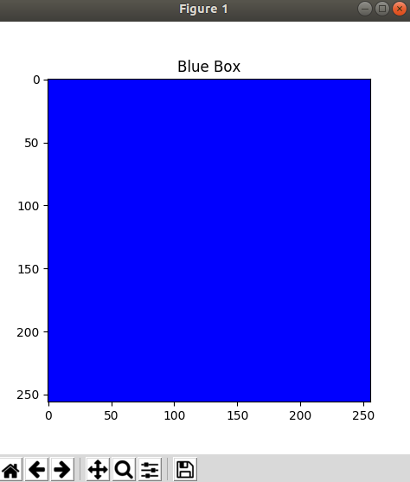
RGB – Blue Box
import numpy as np
import matplotlib.pyplot as plt
import imageio
img_blue = np.zeros((256,256,3), dtype=np.uint8)
for y in range(0, 256):
for x in range(0, 256):
for c in range(0,3):
if c ==2:
img_blue[y][x][c] = 255
else:
img_blue[y][x][c] = 0
plt.imshow(img_blue)
plt.title("Blue Box")
plt.show()

Slide 5
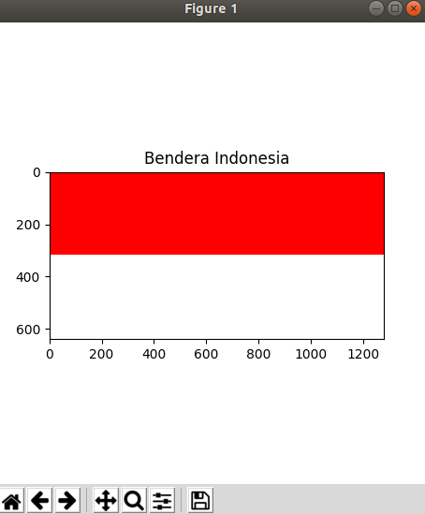
Indonesia Flag
import numpy as np
import matplotlib.pyplot as plt
import imageio
img_indonesia_flag = np.zeros((640,1280,3), dtype=np.uint8)
for y in range(0, 640):
for x in range(0, 1280):
for c in range(0,3):
if y >=320:
img_indonesia_flag[y][x][c] = 255
else:
if c == 0:
img_indonesia_flag[y][x][c] = 255
else:
img_indonesia_flag[y][x][c]=0
plt.imshow(img_indonesia_flag)
plt.title("Bendera Indonesia")
plt.show()

Slide 6
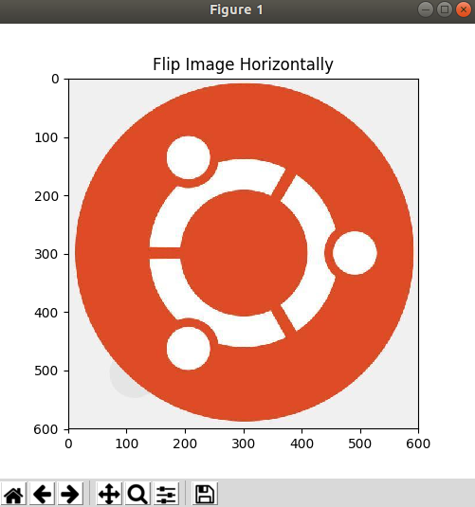
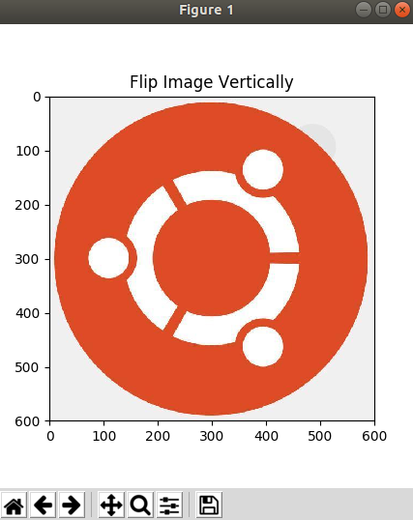
Flip Image
import imageio
import numpy as np
import matplotlib.pyplot as plt
img = imageio.imread("ubuntu.jpg")
img_height = img.shape[0]
img_width = img.shape[1]
img_channel = img.shape[2]
img_type = img.dtype
img_flip_horizontal = np.zeros(img.shape, img_type)
img_flip_vertical = np.zeros(img.shape, img_type)
#flip image horizontally
for y in range(0, img_height):
for x in range(0, img_width):
for c in range(0, img_channel):
img_flip_horizontal[y][x][c] = img[y][img_width-1-x][c]
#flip image vertically
for y in range(0, img_height):
for x in range(0, img_width):
for c in range(0, img_channel):
img_flip_vertical[y][x][c] = img[img_width-1-y][x][c]
plt.imshow(img_flip_horizontal)
plt.title("Flip Image Horizontally")
plt.show()
plt.imshow(img_flip_vertical)
plt.title("Flip Image Vertically")
plt.show()

